Slide 1
Qubits, neural networks and quantum machine learning
By Gio Abou Jaoude

Slide 2
Outline
Qubits
Iris Data Set
Neural Network Benchmark
Quantum Machine Learning

Slide 3
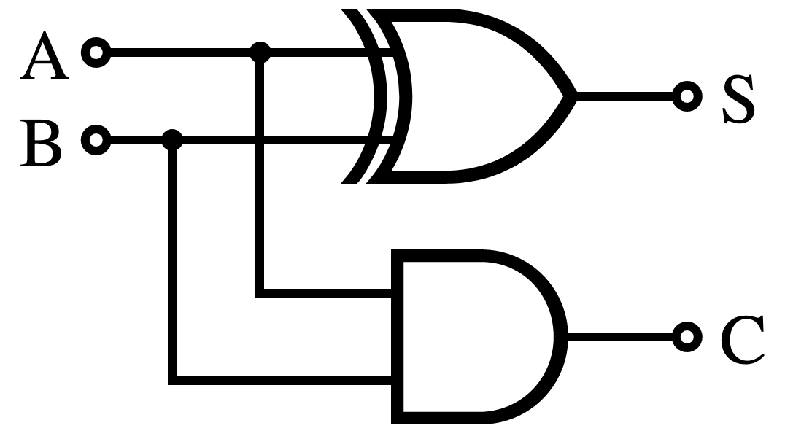
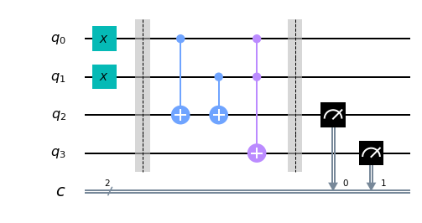
Qubits: Circuits
https://qiskit.org/textbook/ch-states/atoms-computation.html

Slide 4
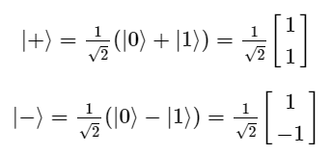
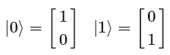
Qubits: Qubit
https://qiskit.org/textbook/ch-states/representing-qubit-states.html
https://qiskit.org/textbook/ch-states/single-qubit-gates.html

Slide 5
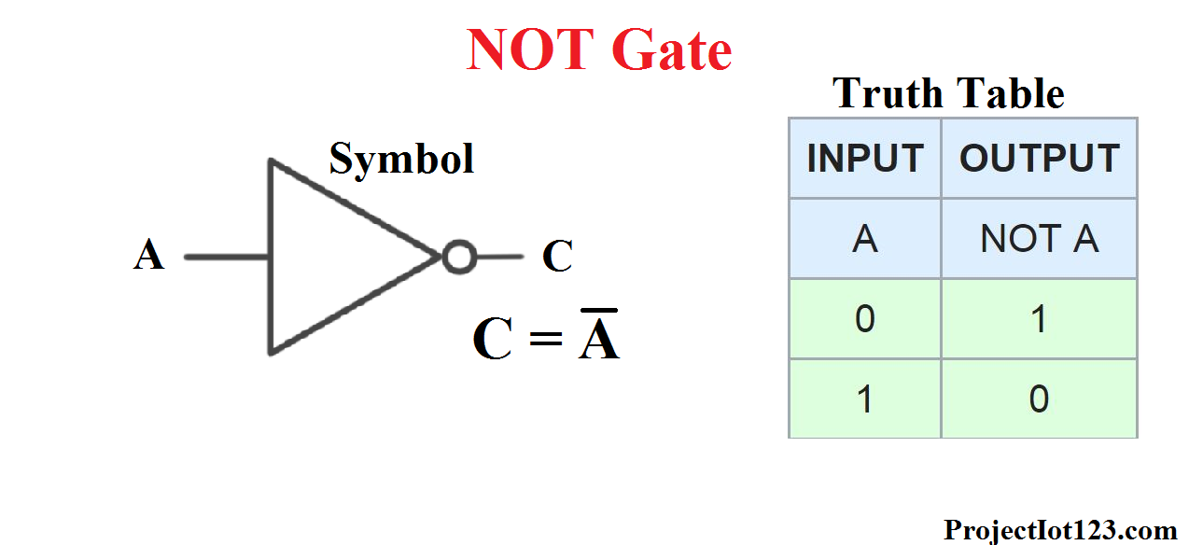
Qubits: X Gate
https://projectiot123.com/2019/05/24/introduction-to-not-gate/
https://qiskit.org/textbook/ch-states/single-qubit-gates.html

Slide 6
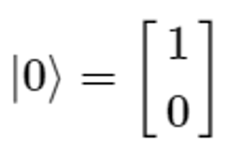
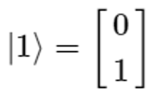
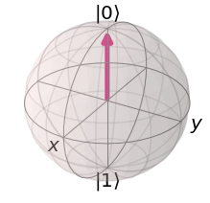
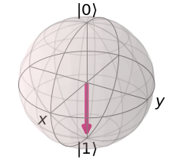
Qubits: Bloch Sphere

Slide 7
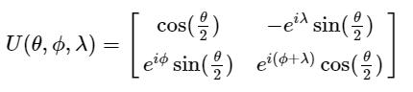
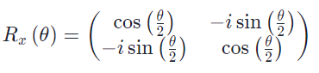
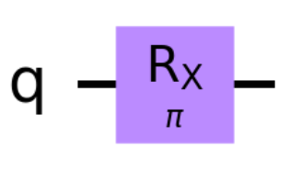
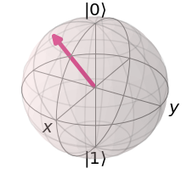
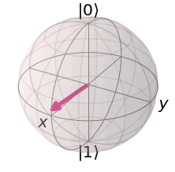
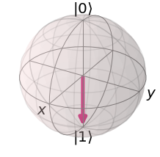
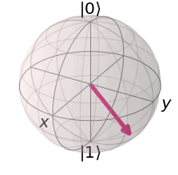
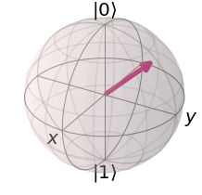
Qubits: Rx gate
https://www.quantum-inspire.com/kbase/rx-gate/
https://qiskit.org/textbook/ch-states/single-qubit-gates.html

Slide 8
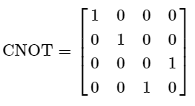
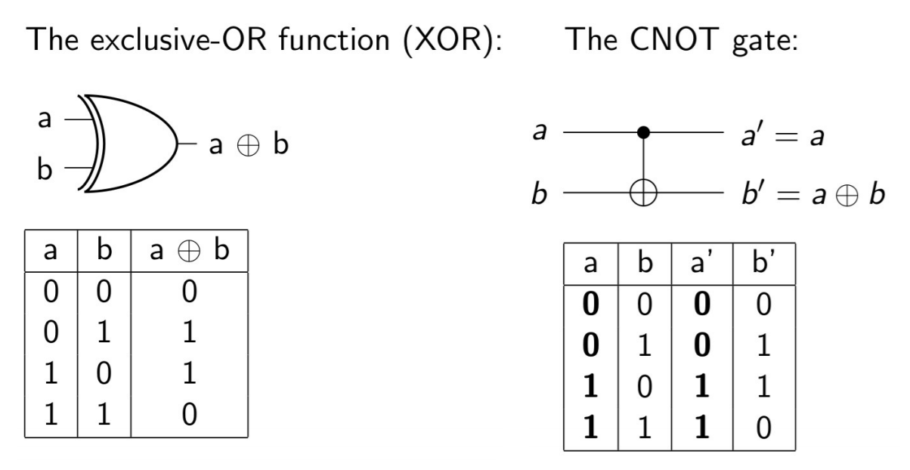
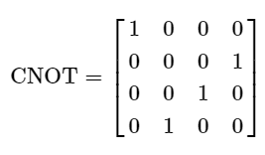
Qubits: CNOT
https://qiskit.org/textbook/ch-gates/multiple-qubits-entangled-states.html
https://indico.in2p3.fr/event/19917/contributions/76740/attachments/56291/74586/qctuto.pdf

Slide 9

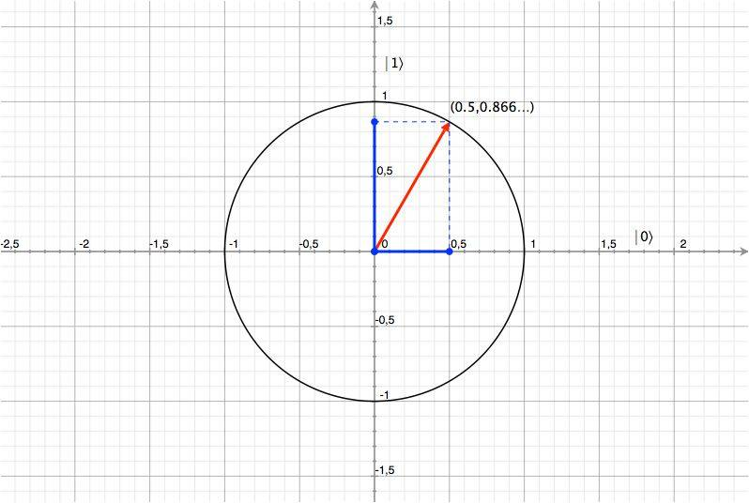
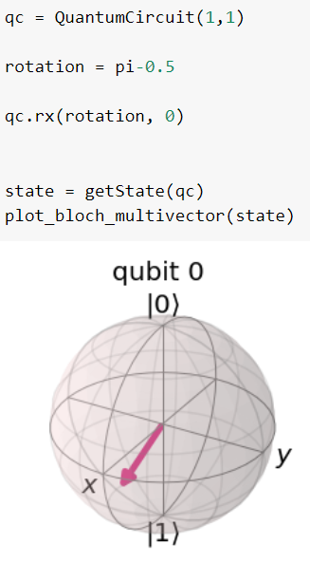
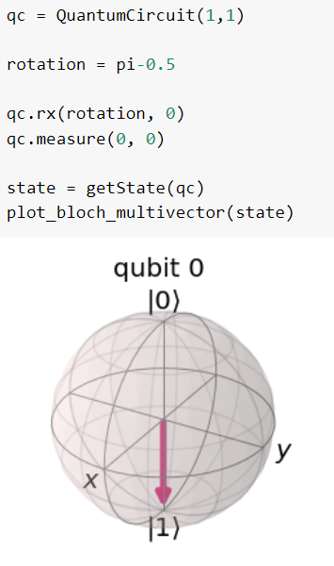
Qubits: Expectation Values & Measurements
https://developer.ibm.com/blogs/quantum-computing-everyone-programmers-perspective//

Slide 10
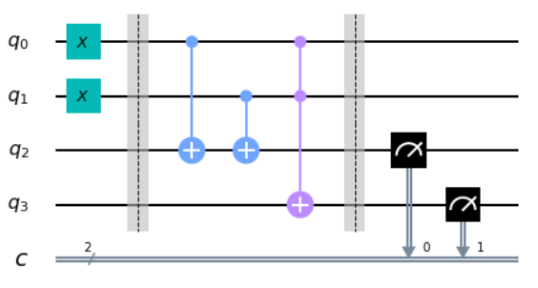
Qubits: Return to Circuit
https://qiskit.org/textbook/ch-states/atoms-computation.html

Slide 11
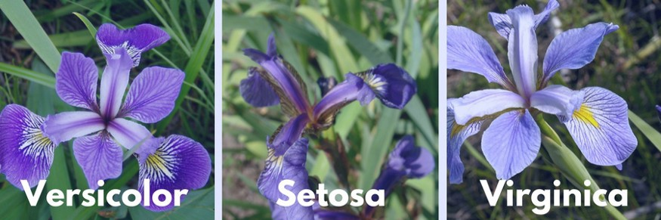
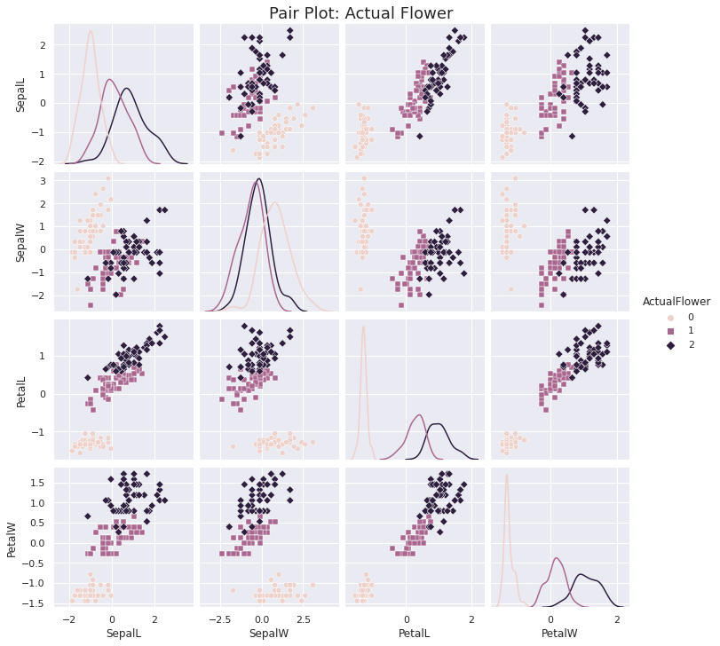
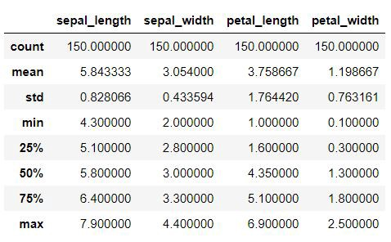
Iris Data Set: Data
https://medium.com/analytics-vidhya/exploratory-data-analysis-iris-dataset-4df6f045cda

Slide 12
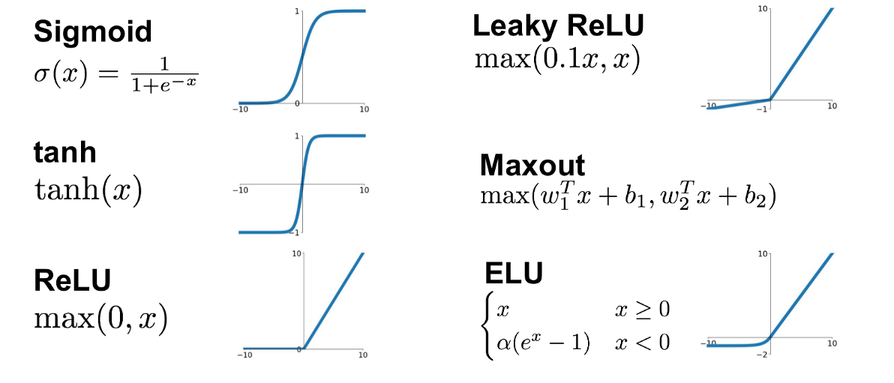
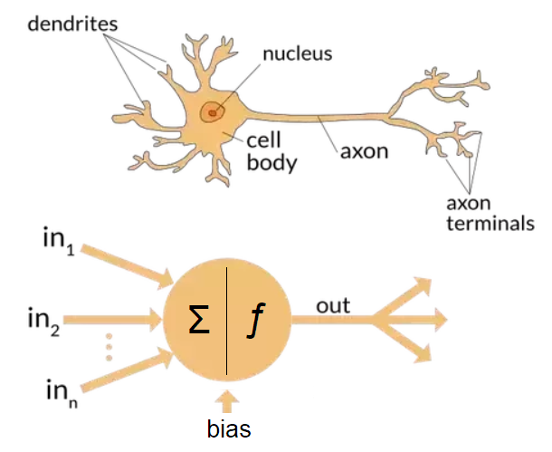
NN: Neurons
https://towardsdatascience.com/the-differences-between-artificial-and-biological-neural-networks-a8b46db828b7
https://abhigoku10.medium.com/activation-functions-and-its-types-in-artifical-neural-network-14511f3080a8
https://medium.com/n%C3%BAcleoml/why-sigmoid-ee95299e11fd

Slide 13
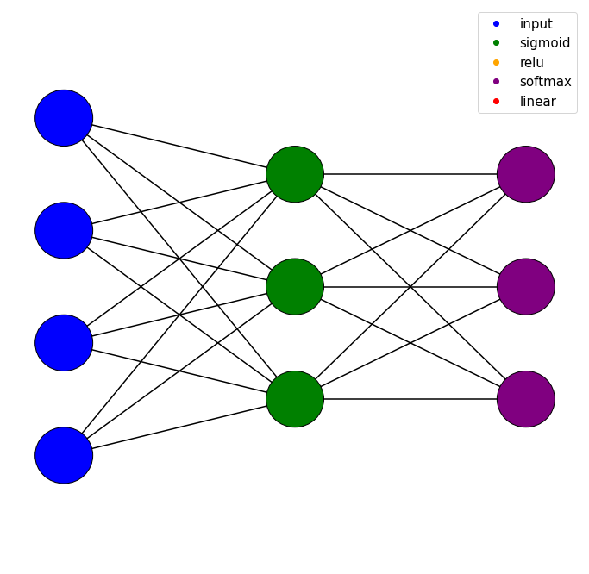
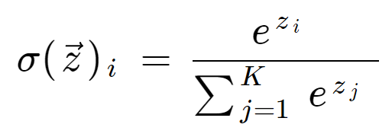
nn: Neural Network
Neural Network Colab Link

Slide 14
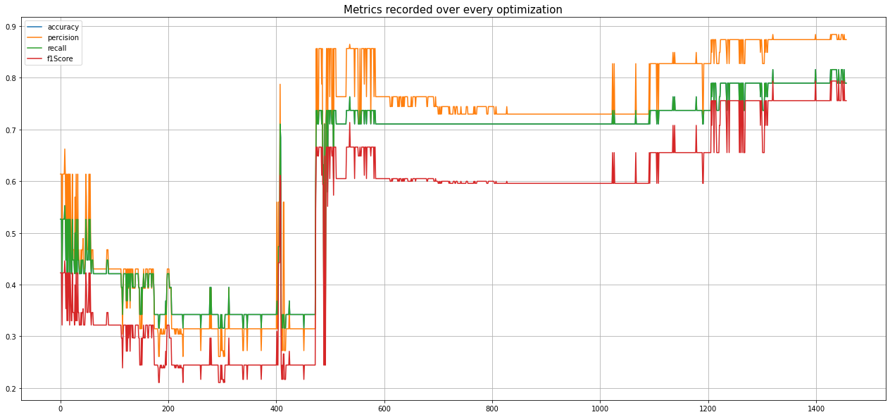
NN: Metrics

Slide 15
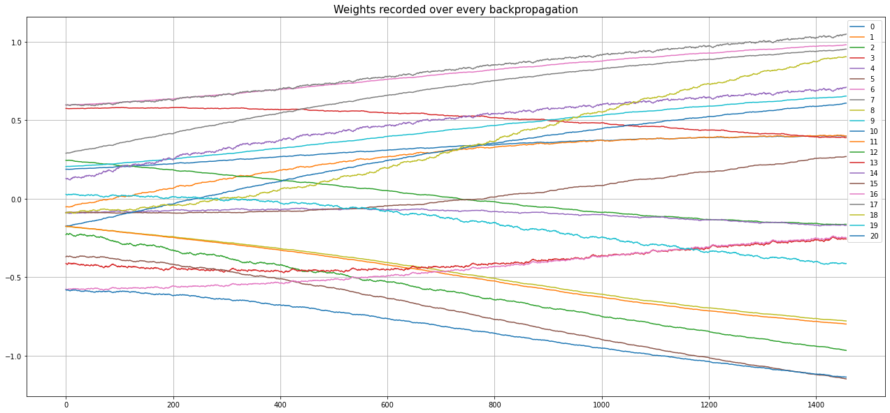
NN: Weights

Slide 16
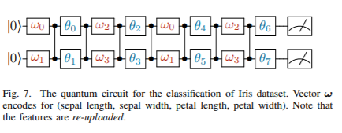
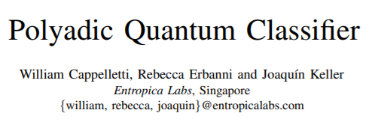
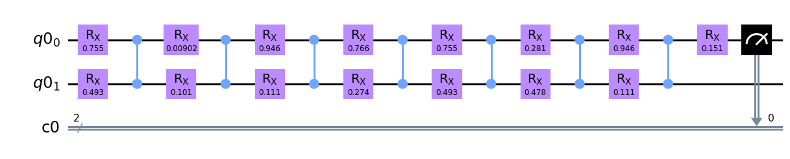
QML: Circuit
QML Colab Link
https://arxiv.org/pdf/2007.14044.pdf

Slide 17
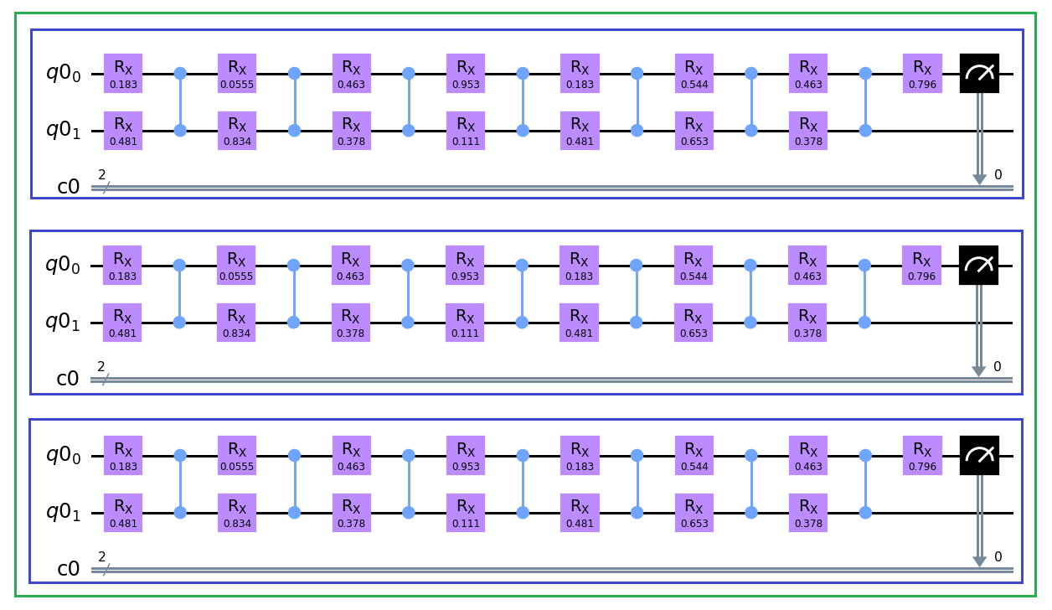
QML: Classifier
Iris #0
Iris #1
Iris #2

Slide 18
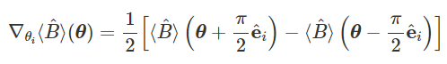

QML: Gradient Parameter-Shift Rule
https://pennylane.ai/qml/demos/tutorial_backprop.html

Slide 19
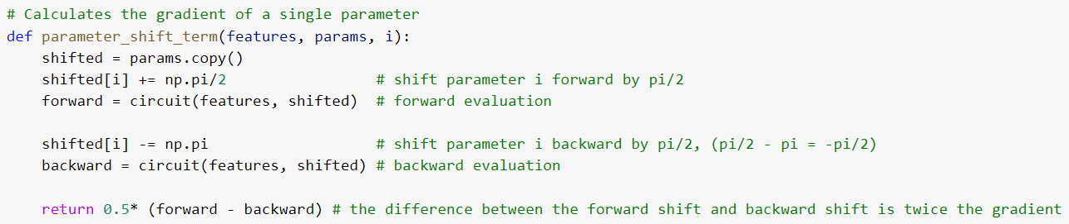
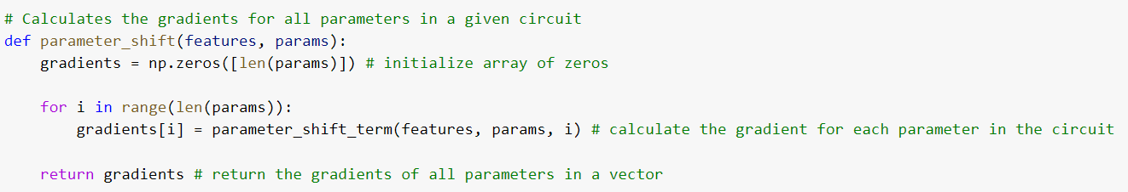
QML: Gradient parameter-shift code
https://pennylane.ai/qml/demos/tutorial_backprop.html

Slide 20
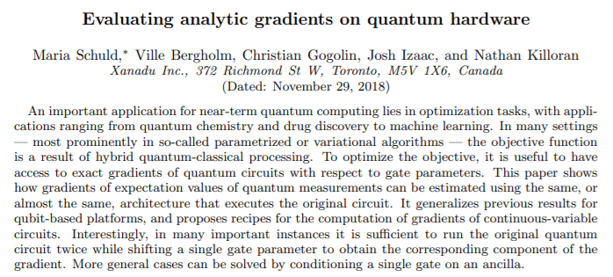
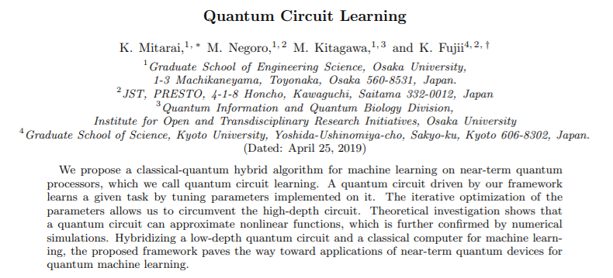
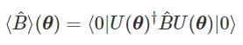
QML: Quantum Gradient further research
https://pennylane.ai/qml/
https://pennylane.ai/qml/glossary/parameter_shift.html
https://arxiv.org/pdf/1811.11184.pdf
https://arxiv.org/pdf/1803.00745.pdf

Slide 21
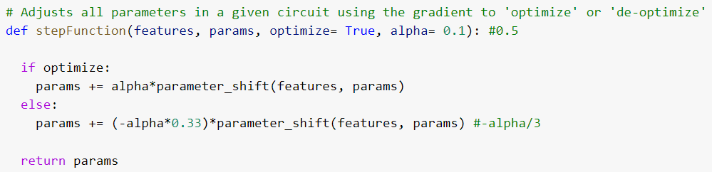
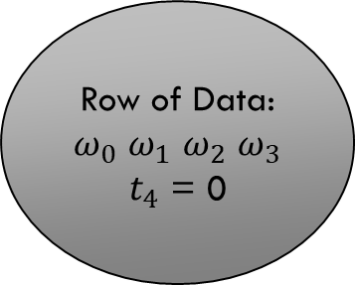
QML: Classifier optimization
Row of Data:
$ω_{0}$ $ω_{1}$ $ω_{2}$ $ω_{3}$
$t_{4}$ = 0

Slide 22
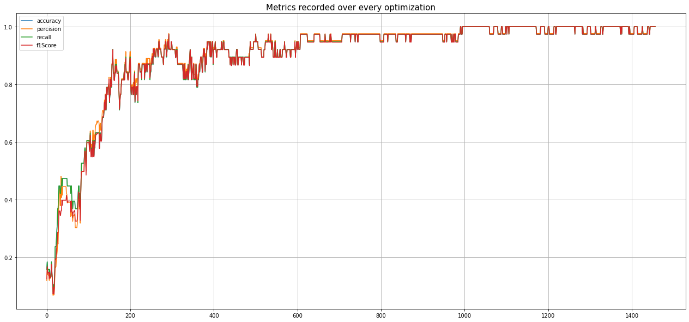
QML: Metrics

Slide 23
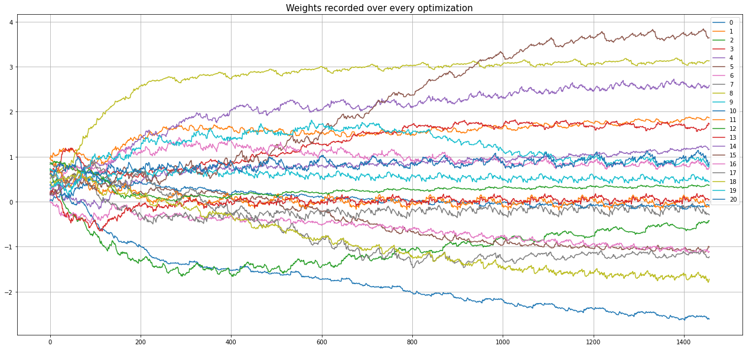
QML: Weights

Slide 24
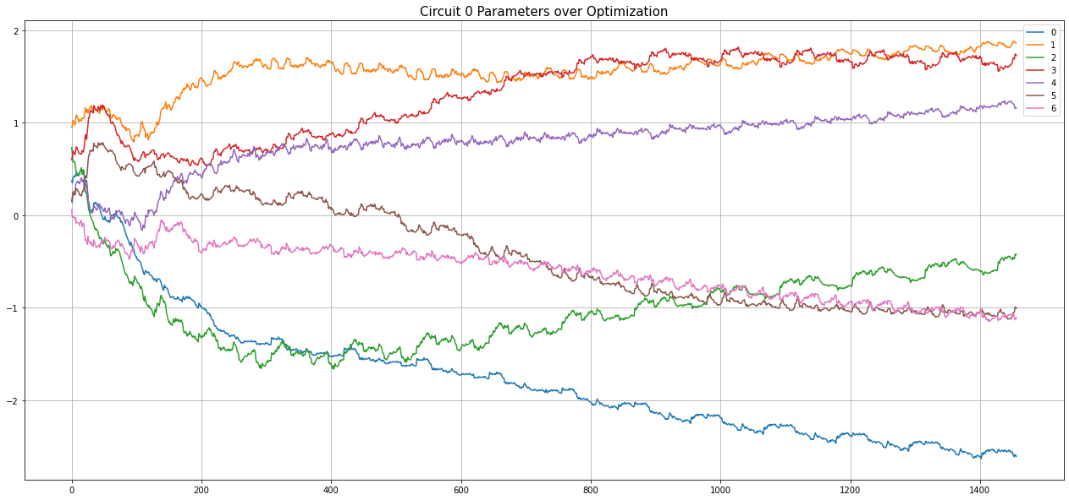
QML: Circuit 0 weights

Slide 25
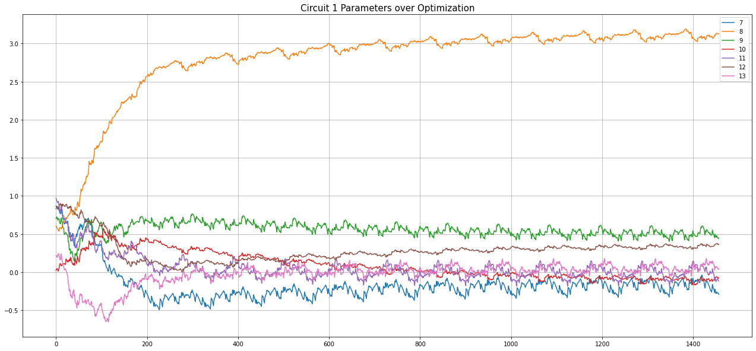
Qml: circuit 1 weights

Slide 26
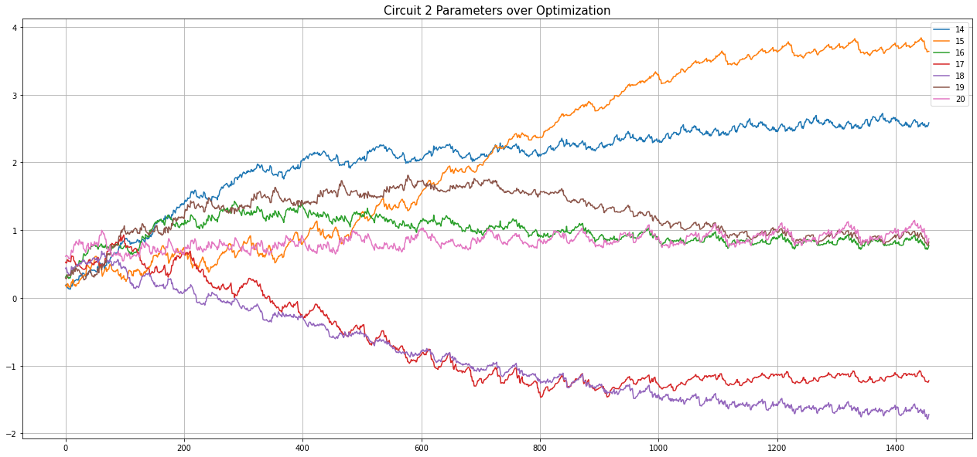
QML: Circuit 2 weights

Slide 27
QML: QML vs classical-NN Weights

Slide 28
QML: QML vs classical-NN Metrics

Slide 29
Goals(old vs. New)
Launch Presentation
HPC & QC neural networks
Create a new dataset
Create dataset briefing
Demonstrate new dataset
Wrap Presentation
Launch Presentation
Create QC neural network prototype using Iris dataset
Verify QCNN on multiple datasets
Publish results of prototype testing

Slide 30
Questions

